Slide 1
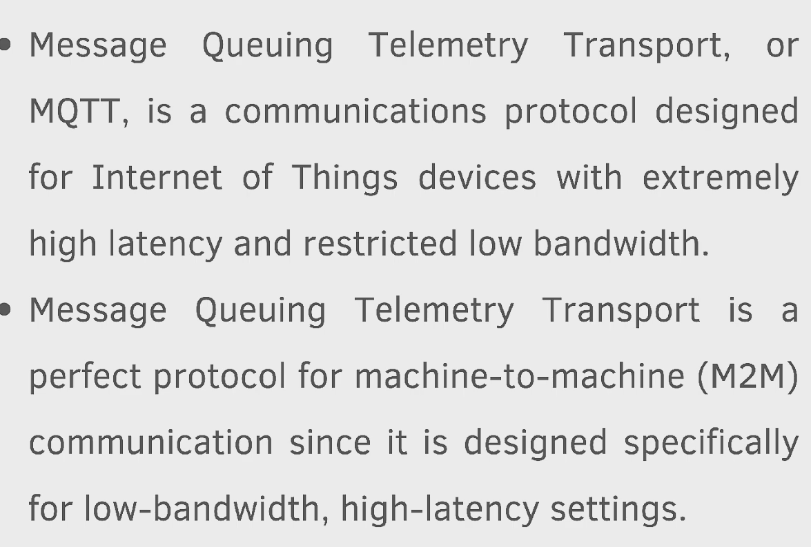

Slide 2
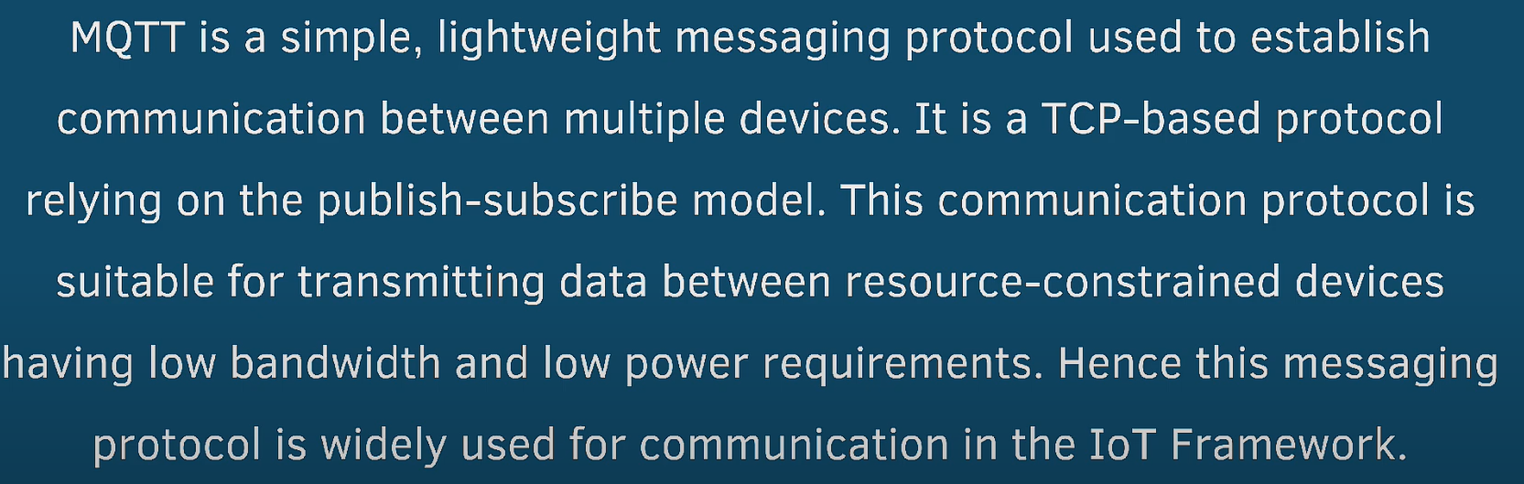

Slide 3
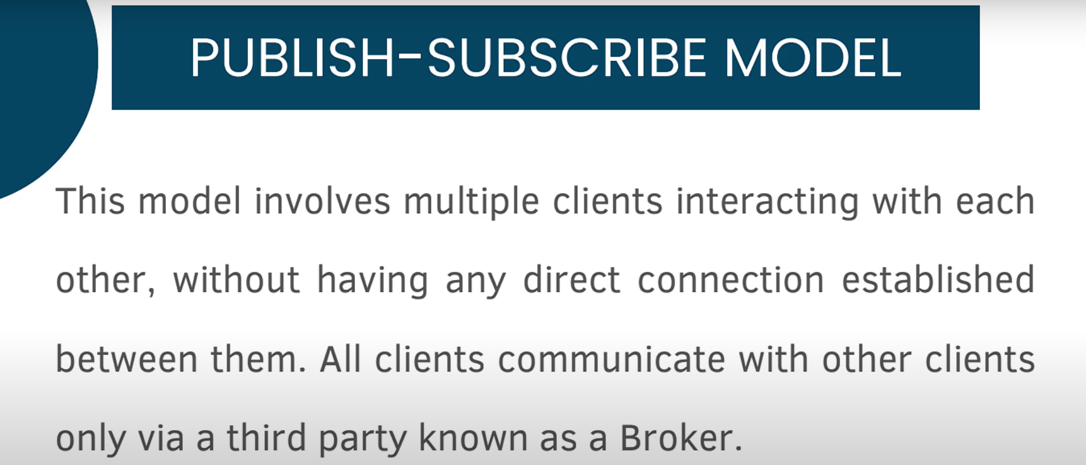

Slide 4
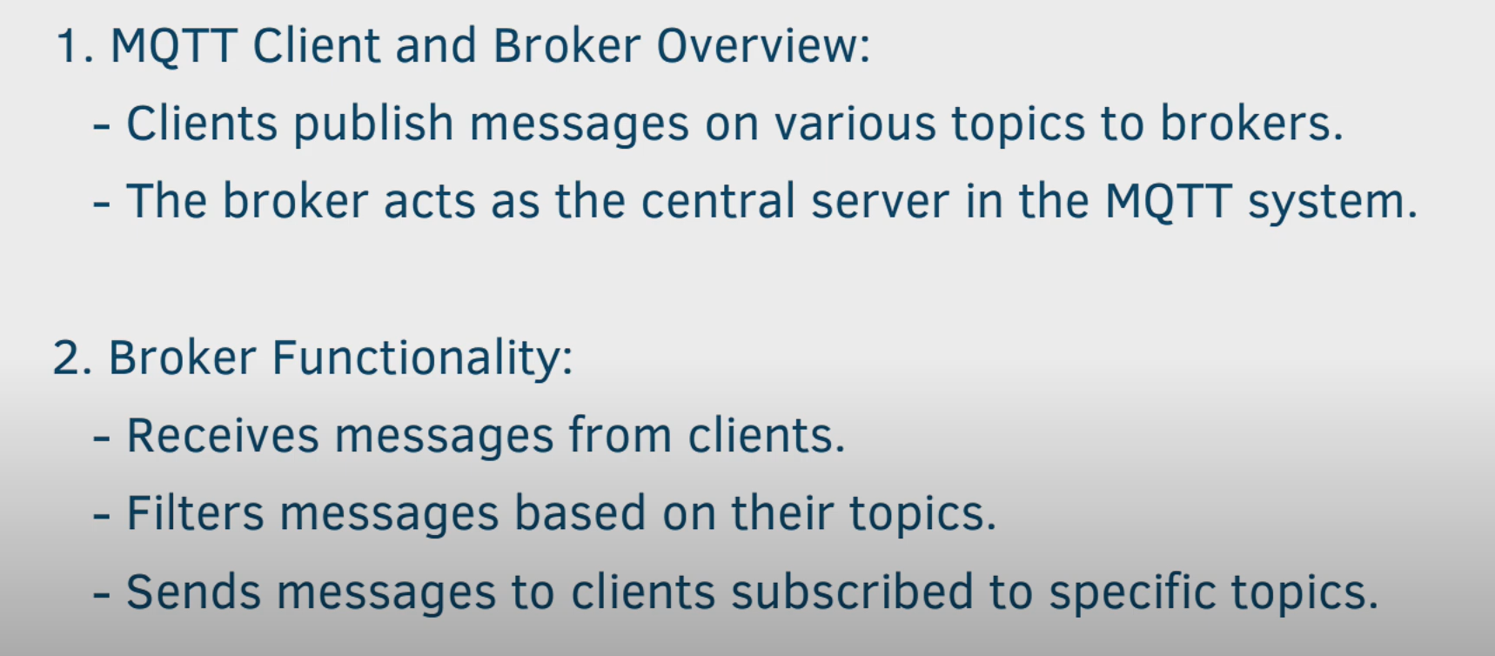
MQTT Client and Broker

Slide 5
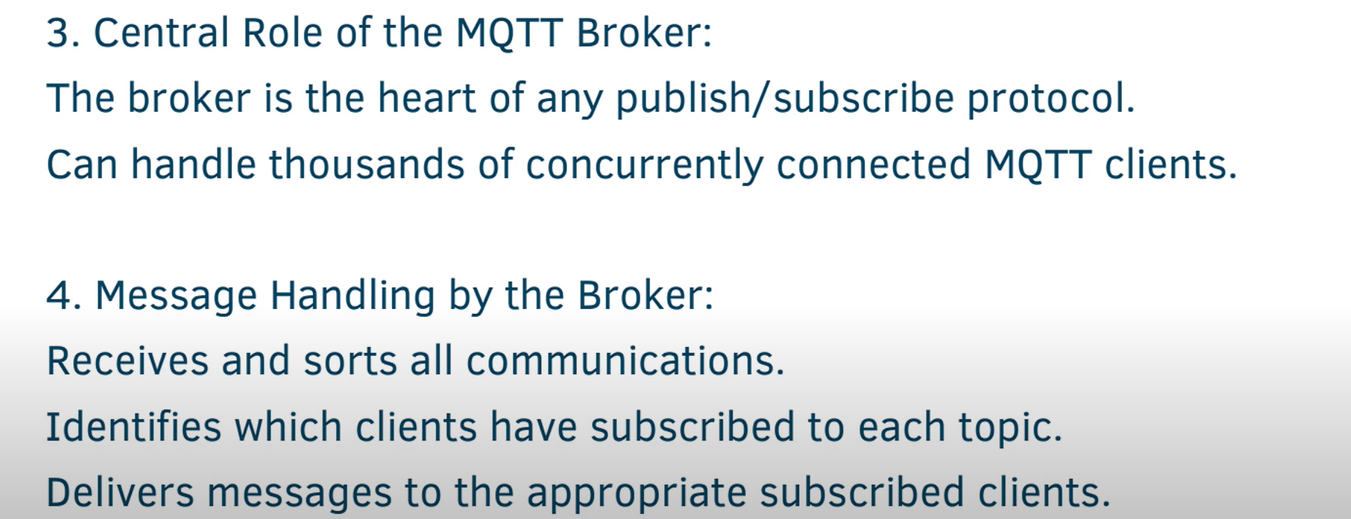

Slide 6
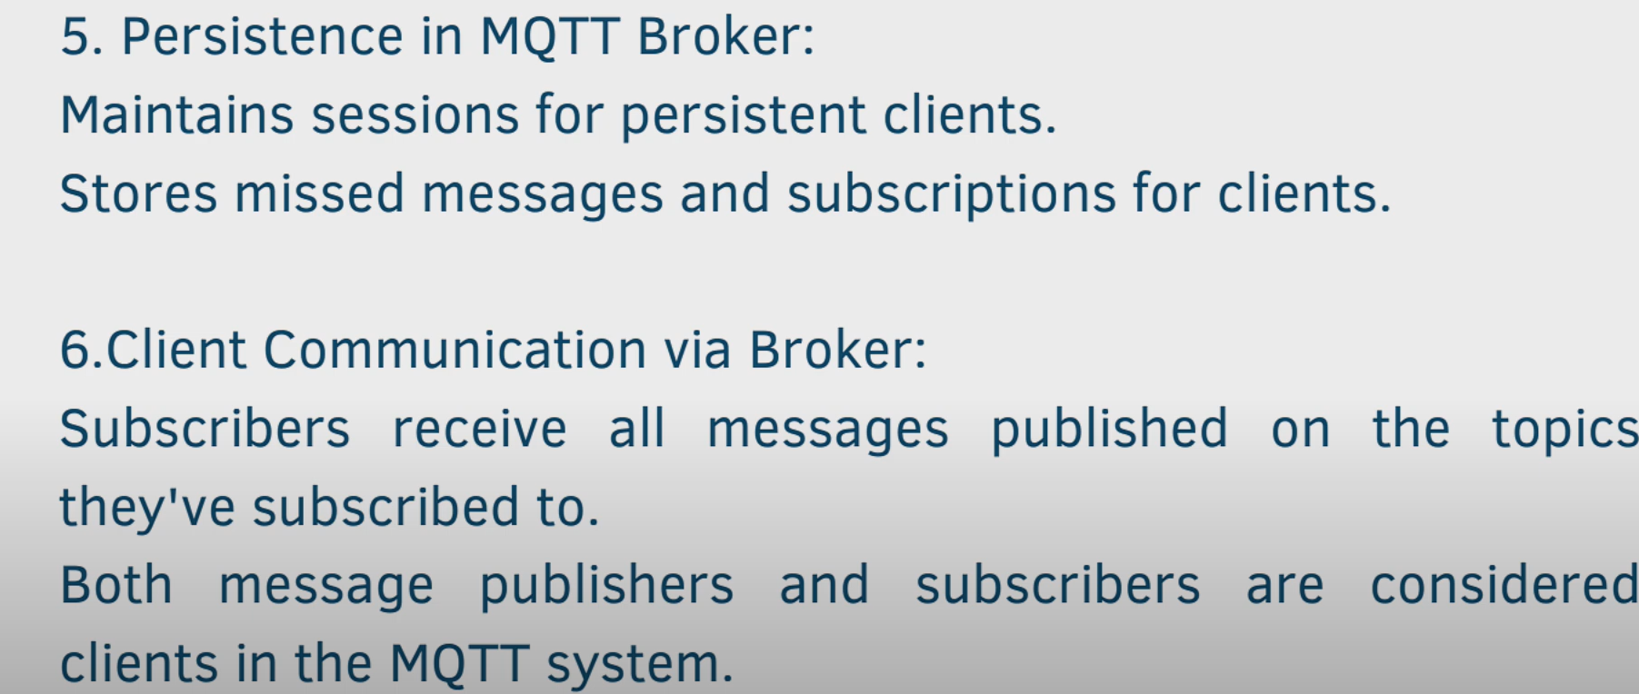

Slide 7
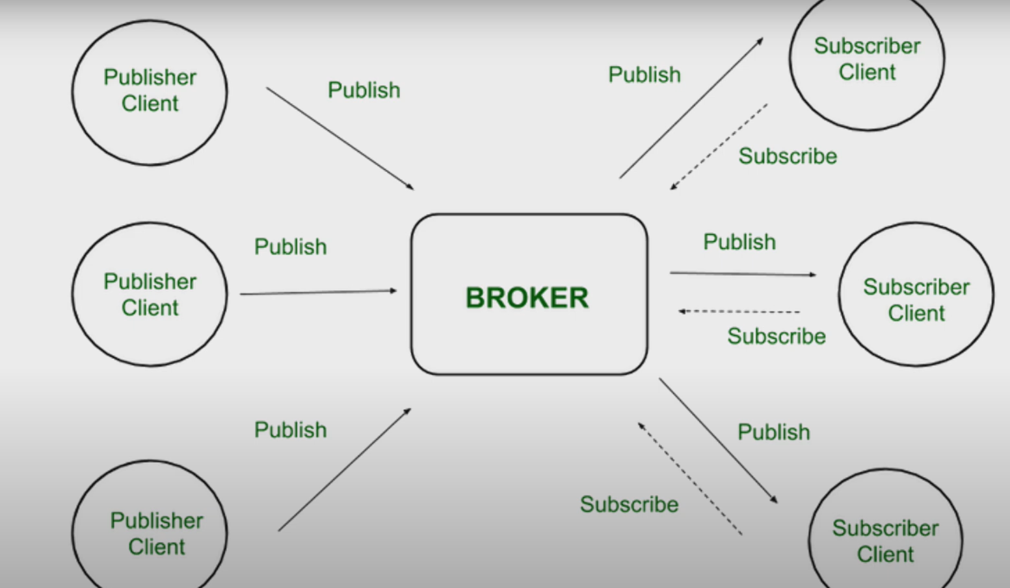

Slide 8
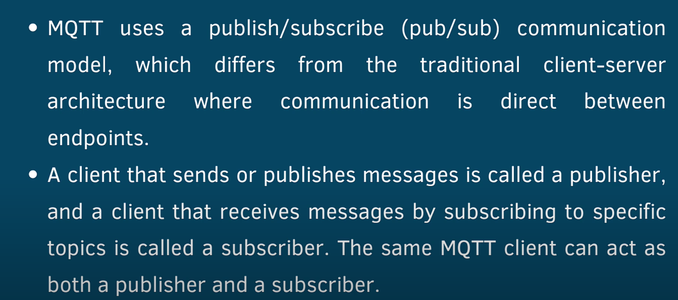
The Working of MQTT

Slide 9
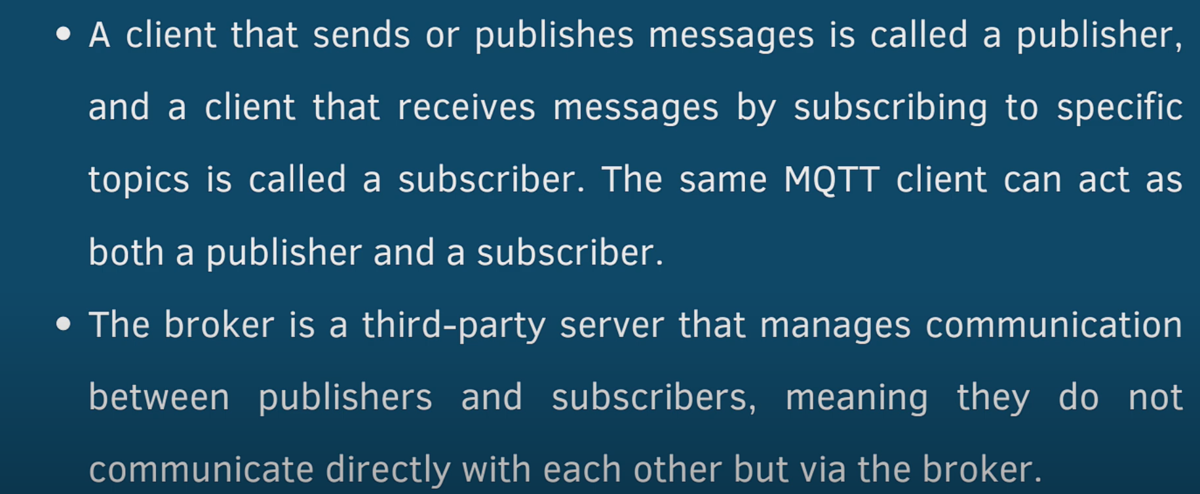

Slide 10
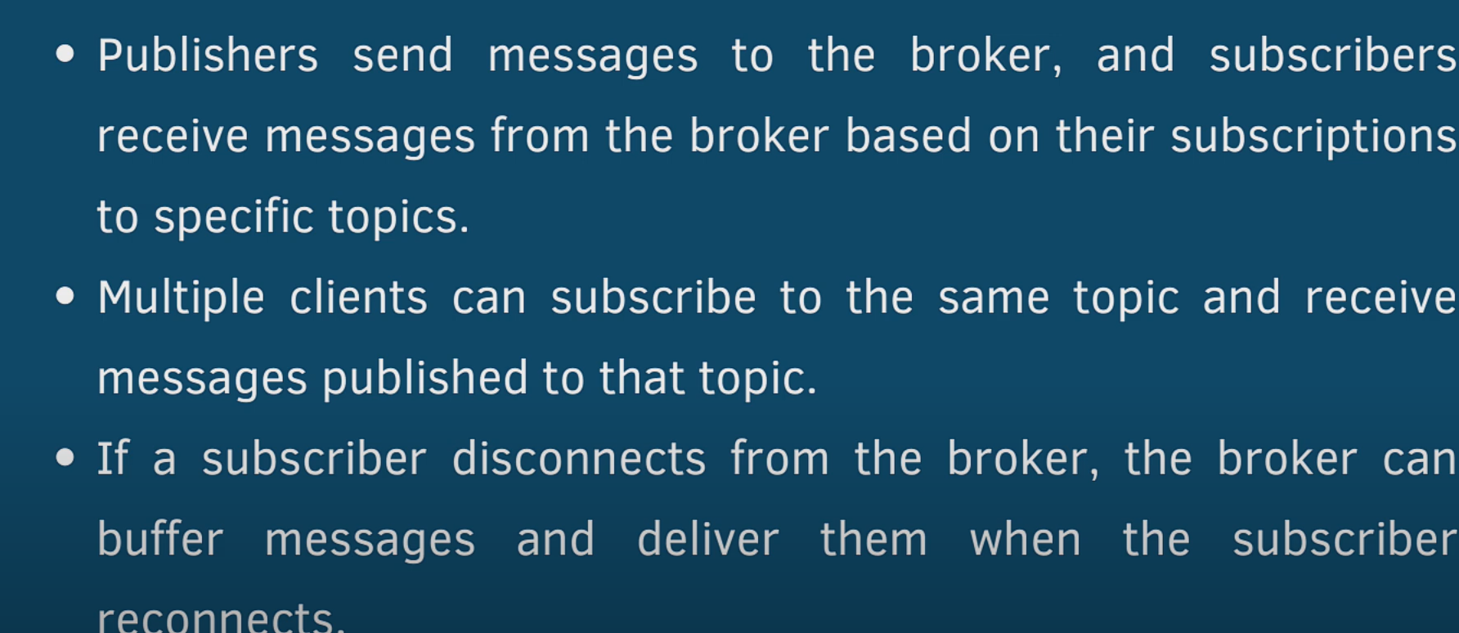

Slide 11
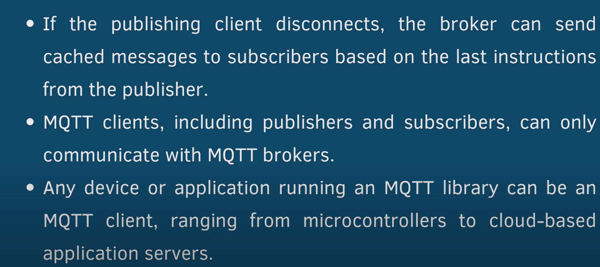

Slide 12
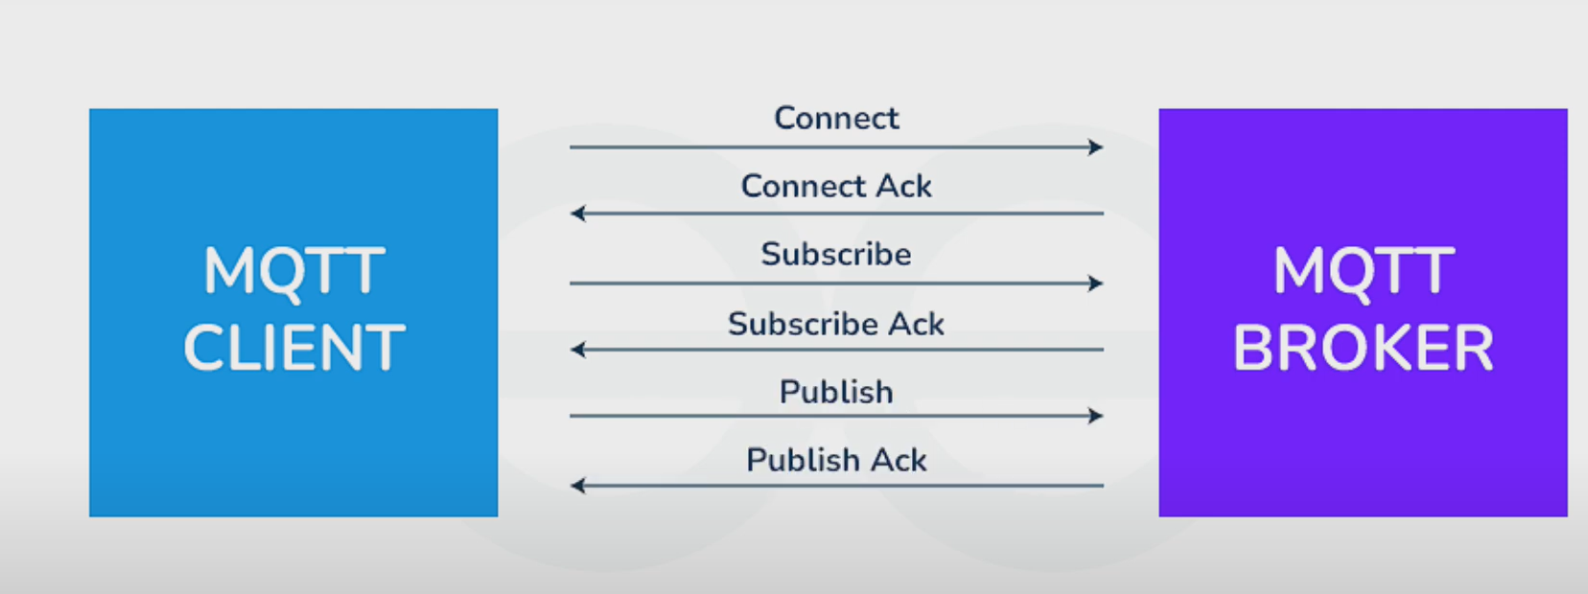

Slide 13
Features:
Lightweight: Optimized for low-resource environments and minimizes bandwidth and processing overhead.
Publish-Subscribe Model: Decouples communication between producers (publishers) and consumers (subscribers).
Quality of Service (QoS): Offers three levels (0, 1, 2) for different levels of message delivery reliability.
Retained Messages: Brokers store the last message on a topic for new subscribers to receive immediately.
Last Will and Testament (LWT): Allows the broker to publish a predefined message if a client disconnects unexpectedly.
Security: Supports TLS encryption and authentication methods like username/password and client certificates.

Slide 14
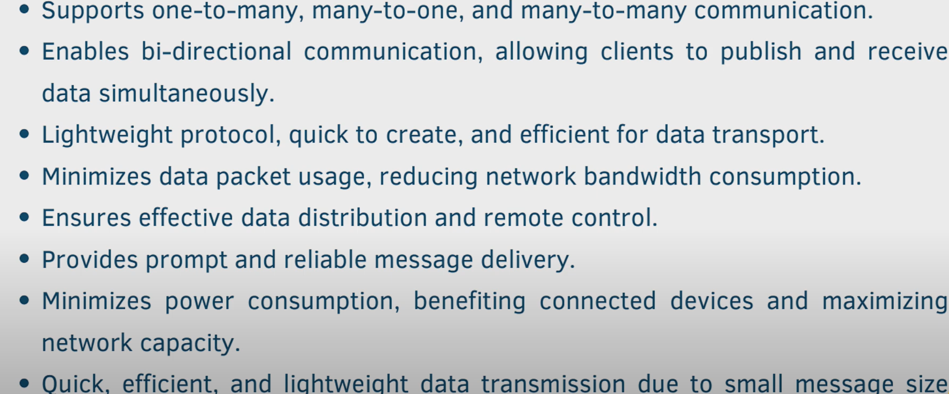

Slide 15
